Slide 1

D208 Predictive Modeling Performance Assessment Task 2: Logistic Regression
Jill Rivera, Student
Masters of Science: Data Analytics
Western Governors University
Notes:
Hello and welcome. My name is Jill Rivera. I am a student in the Master of Science program for Data Analytics. Today, I will be going over the second performance assessment for class D208 Predictive Modeling. This task will focus on Logistic Regression.

Slide 2

Performance Task 2
Given: Data Dictionary and Associated Data Set
Objective: Using Logistic Regression, analyze the data set to answer a beneficial question for the business.
Notes:
This second performance task in Predictive Modeling will focus on analyzing a data set using logistic regression. The analysis will attempt to answer a question that is beneficial to the company’s data set.

Slide 3

Business Question
Which features are significant to the churn variable in the data set?
Notes:
Customer churn is a problem that every company encounters. This analysis will attempt to answer which features are significant to the churn variable in the data set. The data set contains 10,000 customer records from a telecommunications company, with 50 features describing each record. This analysis will use an iteration process to reduce the size of the data set and focus on answering the research question presented.

Slide 4

Agenda
Data Acquisition
Data Cleaning
Data Exploration
Data Wrangling
Model Creation and Refinement
Model Analysis
Results
Recommendations
Questions
Notes:
The process for completing the regression method will be as follows: First, I will clean the data to provide a complete data set with no missing values and treating outlying data points which may skew the model. Next, I will explore the data using descriptive, univariate, and bivariate statistics to ensure that the explanatory variables follow the assumptions of the analysis. Any data that does not follow the assumptions will be removed. Next, I will wrangle the data by re-expressing the categorical features as numerical data to be included in the analysis. Logistic regression uses categorical features as binary values for the calculation.
I will create an initial model using all the data in the data set. Predictor variables with high p-values and/or a high degree of multicollinearity will be eliminated. A reduced model will be created from the remaining data and the final model will be analyzed. Results and recommendations for the business will be presented for consideration.

Slide 5
Logistic Regression
Statistical Technique:
Infers how confidently the value of a target variable can be predicted using the predictor variables.
Assumptions:
Target variable is binary.
Variable independence.
No multicollinearity.
Linearly aligned with log odds.
Large sample size.
Notes:
Logistic regression is used to infer how confidently the value of a target variable can be predicted using the predictor variables that follow the assumptions of the logistic method.
The logistic regression method requires the variables to meet certain parameters. First, the target variable must be binary. Second, the variables should all be independent of each other. Third, there can be little to no multicollinearity among the independent variables. Next, the independent variables be linearly aligned with the log odds. Lastly, this analysis method requires a large sample size with a minimum of 10 independent variables.

Slide 6
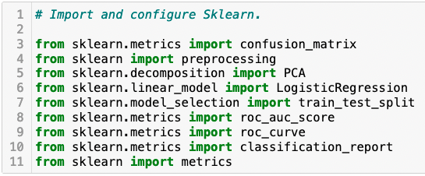
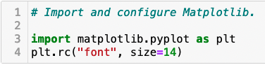
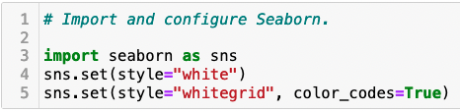
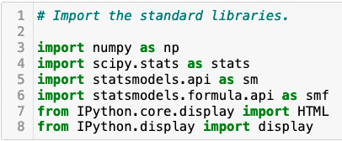
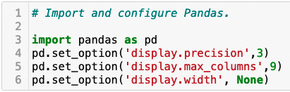
Data Acquisition
Notes:
The first step of this process is to pull the data into a Jupyter Notebook and import all of the library packages we will need. The tools selected for this model creation are Jupyter Notebook, Python, Pandas, Statsmodels, Matplotlib, and Seaborn. Jupyter Notebook is an open-source web application that allows you to document, and visualize your results in the same place, using multiple coding languages. Python is a powerful, open-source programming language that has a plethora of supporting libraries and is very easy to read and write. Pandas is a Python library that makes reading and manipulating the data frame easy. Statsmodels is a gathering of classes and functions for the use of estimating various statistical models. Lastly, Matplotlib and Seaborn are libraries that are used to plot graphical visualizations.

Slide 7
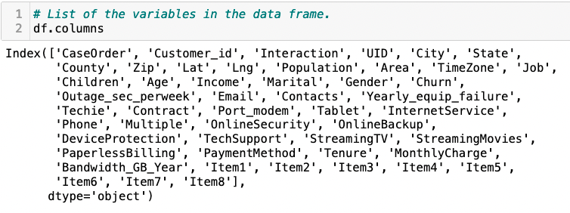
Data Cleaning: Variables
Notes:
The data will first be prepared for the logistic regression calculation. The data will be cleaned to ensure it is complete and is free from outlying factors. Next, the data will be explored using descriptive statistics and univariate and bivariate visualizations. Finally, the data will be wrangled, and the categorical features will be re-expressed as numerical values. Lastly, the clean data frame will be extracted into a CSV file for submission. To answer our business question, the target variable will be Churn and the remaining variables will be predictor variables.

Slide 8
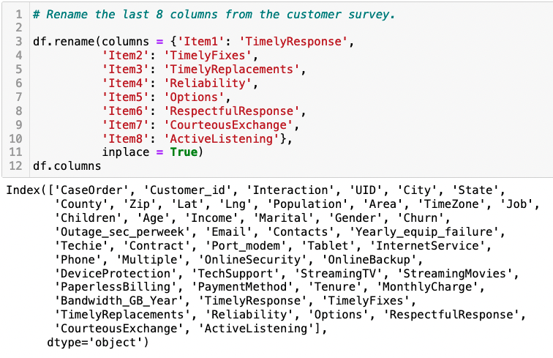
Data Cleaning: Rename Columns
Notes:
First, the last eight features from the customer survey are renamed for easier reading.

Slide 9
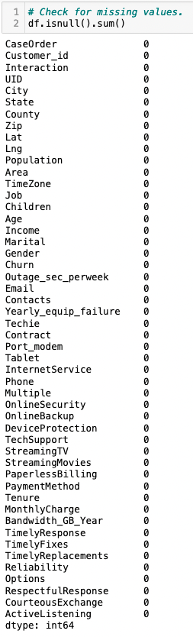
Data Cleaning: Missing Values
Notes:
Then, missing values are detected using the isnull method along with the sum method. This verifies that there is no missing data in the data frame.

Slide 10
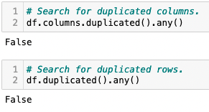
Data Cleaning: Duplicated Values
Notes:
Next, duplicated columns and rows are detected using the duplicated and any methods. We find that no rows or columns are duplicated.

Slide 11
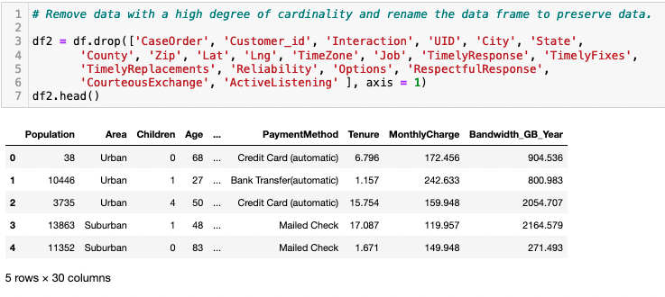
Data Cleaning: Remove Columns
Notes:
Then, features with a high degree of cardinality are removed from the data set so that they do not skew the calculations. There are now 30 features in the data set.

Slide 12
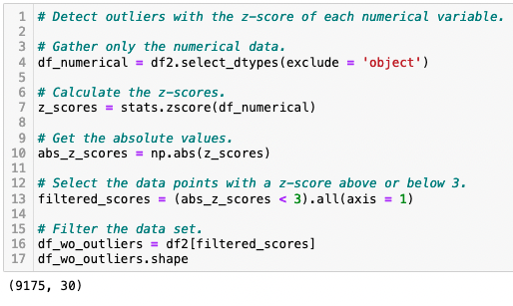
Data Cleaning: Outlying Values
Notes:
Finally, outliers are found in the data using their z-score and eliminated from the data set. We can see that the data went from 10,000 records to 9175, dropping the 825 customer records with outlying values.

Slide 13
Data Exploration: Descriptive Statistics
Numerical Data
Label | Range | Mean
Population | 0 - 5267 | 8527.72 +/- 11802.99
Children | 0 - 8 | 1.95 +/- 1.90
Age | 18 - 89 | 53.08 +/- 20.65
Income | 348.67 – 124025.1 | 38298.94 +/- 25056.13
Outage_sec_perweek | 1.144796 – 18.85173 | 10.01 +/- 2.93
Email | 3 - 21 | 12.02 +/- 3.01
Contacts | 0 - 3 | 0.94 +/- 0.90
Yearly_equip_failure | 0 - 2 | 0.37 +/- 0.58
Tenure | 1.005104 – 71.99928 | 34.44 +/- 26.45
Monthly Charge | 79.97886 – 290.160419 | 172.73 +/- 42.99
Bandwidth_GB_Year | 155.5067148 – 7158.98153 | 3380.57 +/- 2186.23
Notes:
Summary statistics of all variables (target and predictor) used to answer the research question are shown in the next two tables. The numerical table shows the label, range and mean of each variable.

Slide 14
Data Exploration: Descriptive Statistics
Categorical Data
Label | Values
Area | Urban, Suburban, Rural
Marital | Widowed, Married, Separated, Never Married, Divorced
Gender | Male, Female, Nonbinary
Churn | Yes, No
Techie | Yes, No
Contract | One year, Month-to-month, Two Year
Port_modem | Yes, No
Tablet | Yes, No
InternetService | Fiber Optic, DSL, None
Phone | Yes, No
Multiple | Yes, No
OnlineSecurity | Yes, No
OnlineBackup | Yes, No
DeviceProtection | Yes, No
TechSupport | Yes, No
StreamingTV | Yes, No
StreamingMovies | Yes, No
PaperlessBilling | Yes, No
PaymentMethod | Credit Card (automatic), Bank Transfer (automatic), Mailed Check, Electronic Check
Notes:
The categorical table shows the label and values of each variable. Most of the categorical features have yes and no values, making encoding them later as binary easier. The categories of marital and payment method will need to be reduced in the number of values for them to be re-expressed as numerical data for the calculation.

Slide 15
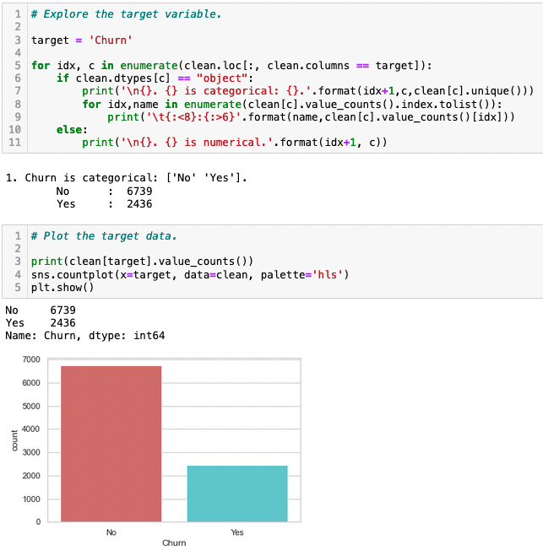
Data Exploration: Target Variable
Notes:
The target categorical variable of churn is explored deeper. The count for each value is displayed and visualized on a graph.

Slide 16
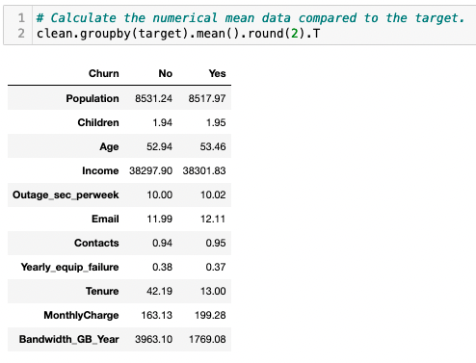
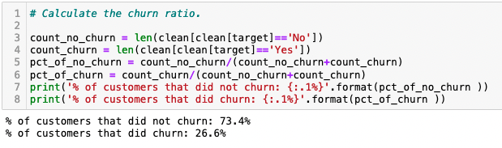
Data Exploration: Target Variable
Notes:
Next, the ratio of positive (yes) and negative (no) values are calculated. We can see that the data is not evenly distributed between yes and no values. This will need to be balanced with predictor data for the model creation to maintain the assumptions of the logistic method.
Finally, the totals of positive and negative values for each remaining feature are calculated. From this, it can be determined that the customers who churn have a much lower tenure than those who stay with the provider. Those leaving are also paying a higher monthly charge, using significantly less bandwidth and have a slightly higher income.

Slide 17
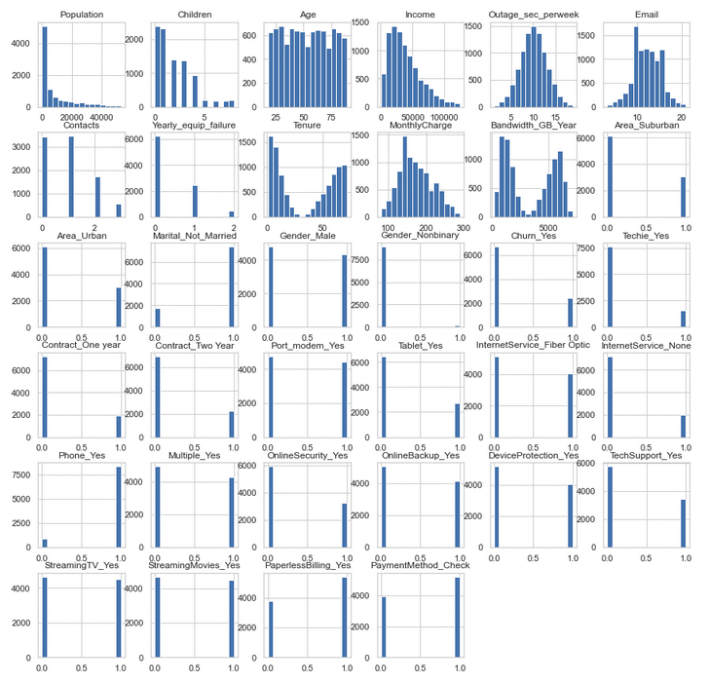
Data Exploration: Univariate Statistics
Notes:
Univariate visualizations of the distribution of variables in cleaned data set are shown. Histograms of the numerical data show the distribution patterns. Even distribution can be seen in the age, outage_sec_perweek, email, gender_male, port_modem_yes, multiple_yes, streamingTV, and streamingmovies graphs. The remaining features have an uneven distribution that will be addressed in the model.

Slide 18
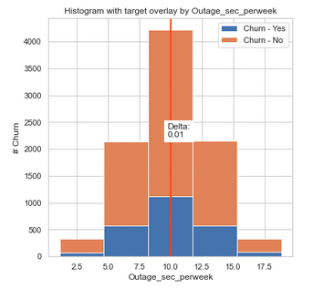
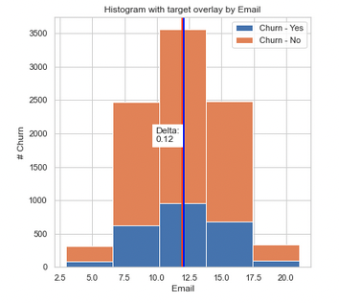
Data Exploration: Bivariate Statistics
Notes:
Bivariate histograms are created to compare the explanatory variables to the target variable of Churn. Outage_sec_perweek and Email in relation to churn both show a normal distribution pattern, with the mean and median very close in value.

Slide 19
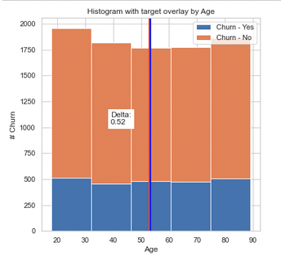
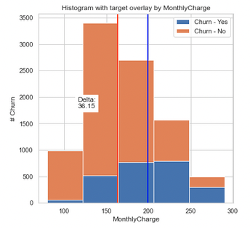
Data Exploration: Bivariate Statistics
Notes:
When comparing age and monthly charge to churn, they are fairly evenly distributed as well. Monthly charge however is slightly skewed to the right indicating a positive correlation.

Slide 20
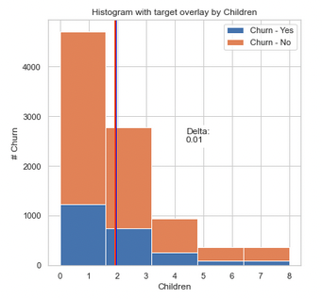
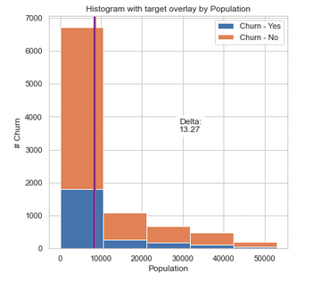
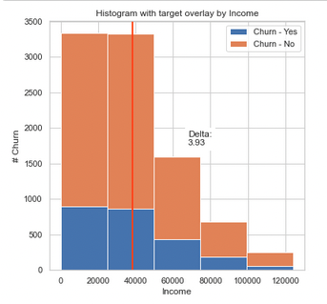
Data Exploration: Bivariate Statistics
Notes:
More positively skewed variables can be seen when comparing children, population and income against churn.

Slide 21
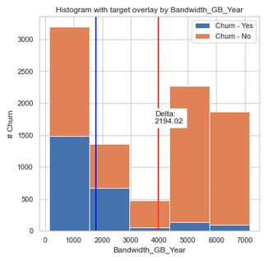
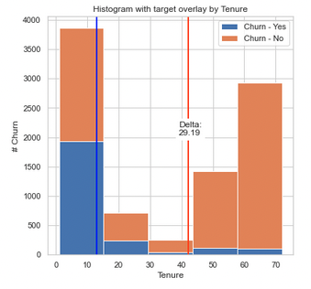
Data Exploration: Bivariate Statistics
Notes:
The bandwidth and tenure features show a bimodal pattern when compared to churn. This indicates that there are two data points that are peaking the volume of data, separating the median and mode.

Slide 22
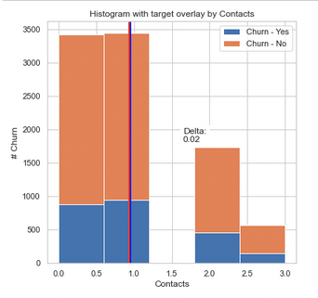
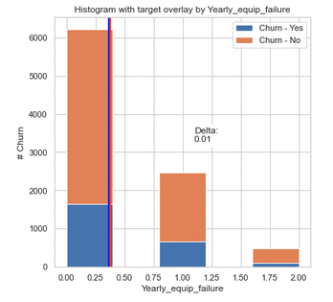
Data Exploration: Bivariate Statistics
Notes:
Additional positively right-skewed data can be seen when comparing churn against yearly equipment failure and contacts.

Slide 23
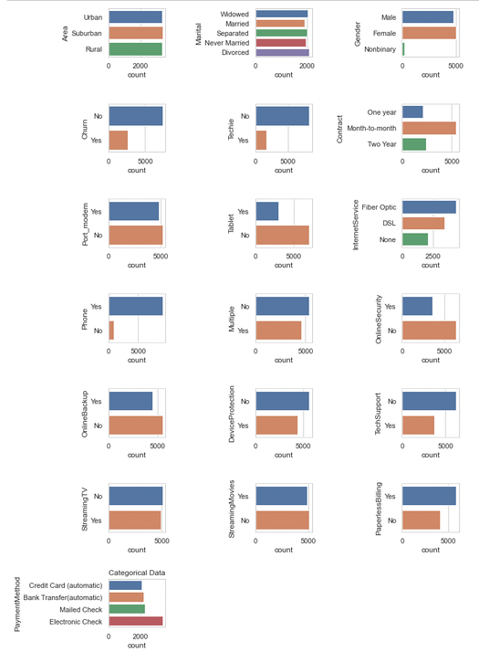
Data Wrangling: Visualize Categorical Variables
Notes:
Categorical features must be addressed before creating the logistic model for this analysis. First, the categorical variables are visualized in plots. The features with more than three values will be re-expressed to only contain two values each, so that the categorical data can be then converted into numerical data.

Slide 24
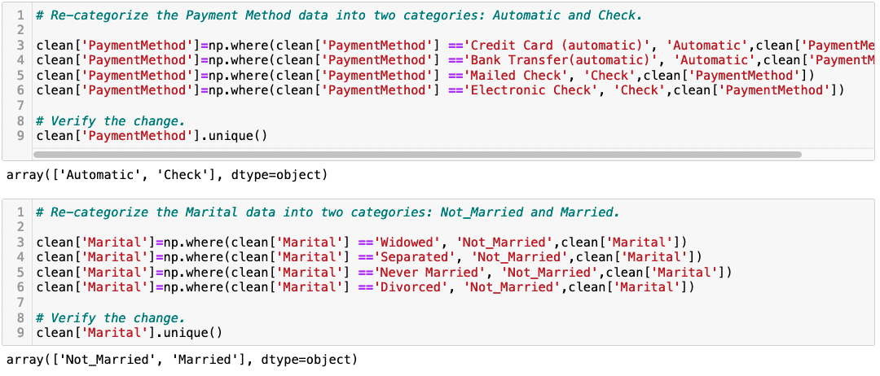
Data Wrangling: Re-express Categorical Features
Notes:
The features of payment method and marital are re-expressed in this method. Payment method is changed to have the values of either automatic or check. Marital is reduced to either married or not married.

Slide 25
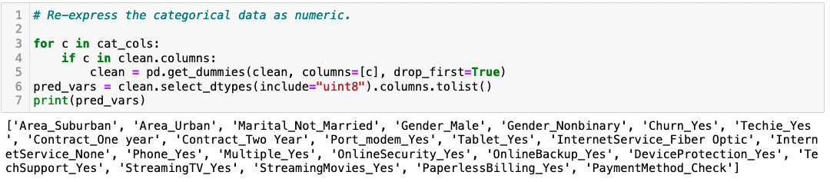
Data Wrangling: Re-express Categorical Features
Notes:
Finally, the categorical data is converted into numerical data using the one-hot encoding method. This indicates a 1 if the category has a positive or yes value and a 0 if the value is a no, changing it to a binary numerical feature.

Slide 26
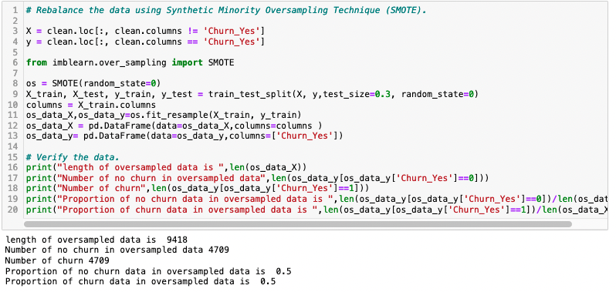
Initial Model: Balancing Features
Notes:
Before the initial model can be created, the data must be rebalanced. With the data being imbalanced, there are too few examples of the minority class for a model to effectively learn the decision boundary. The data is rebalanced using the Synthetic Minority Oversampling Technique (SMOTE). This technique creates synthetic samples that are close to the feature so that the majority and minority data are balanced in quantity.

Slide 27
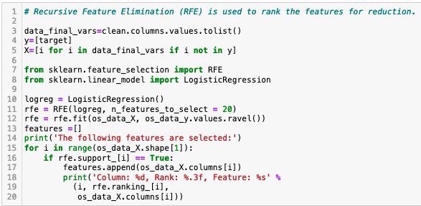
Initial Model: Build
Notes:
The Recursive Feature Elimination (RFE) process is now used to rank the features. The features are ranked based on how relevant they are at predicting the target variable. The feature selection and linear model libraries are imported, then a loop is created to perform the RFE.

Slide 28
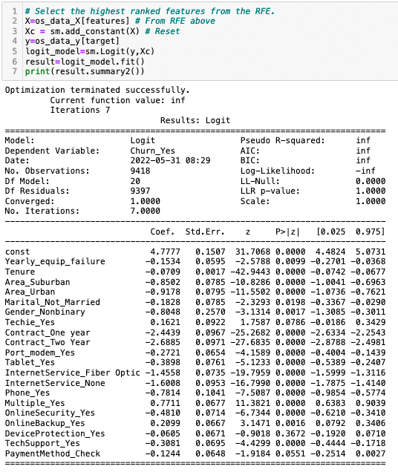
Initial Model: Summary
Notes:
The features that are ranked the highest are selected. The summary shows that the RFE went through seven iterations with 20 features. This shows a few variables with p-values higher than 0.05, which will need to be addressed before running the next model. We can see marital_not_married, device protection and techie are the features with the highest p-values.

Slide 29
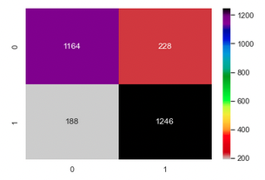
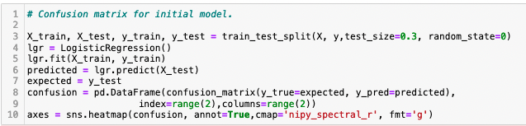
Initial Model: Confusion Matrix
Notes:
A confusion matrix is created for the initial model to describe the performance of the model. This plots the expected and predicted data against each other. In this graph, we can see a total of 2806 predictions were made by the model. The model predicted 1474 positive and 1332 negative values, with the positive values being customers who churn. In actual numbers, 1414 customers churned and 1392 did not.

Slide 30
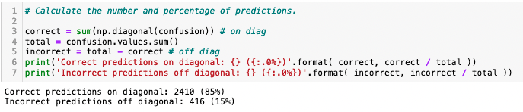
Initial Model: Prediction Accuracy
Notes:
The number of predictions and the ratio of each are calculated for the model. The model created 85% correct predictions. Next, the model will be reduced to increase that correct value on the next model.

Slide 31
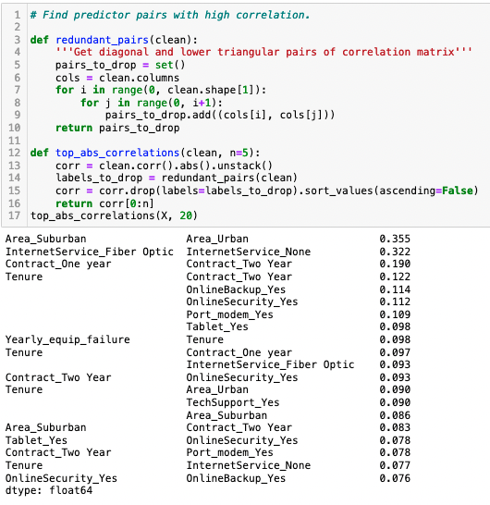
Initial Model: Collinearity
Notes:
Finally, predictor pairs with high correlation are found by using a function so that the process can be re-run again later. The pairs with highest correlation are area with urban and suburban values, and internet service with fiber optic and none values. One value from each pair must be eliminated to prevent skewing or overfitting the data.

Slide 32
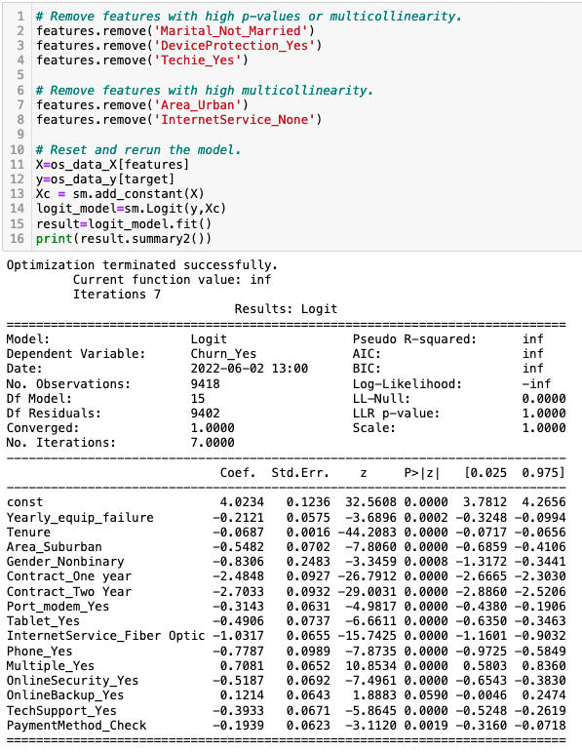
Final Model: Build
Notes:
The reduced and final model is created by first eliminating the features with high p-values and splitting up highly correlated pair of features. The model now has 15 explanatory variables to run through the RFE process. The variables for the model are reset and the model is run again. After seven iterations, the summary is shown. All p-values now are below our metric of 0.05.

Slide 33
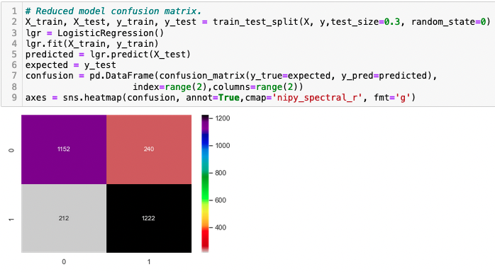
Final Model: Confusion Matrix
Notes:
A confusion matrix for the reduced model is created. This time, a total of 2796 predictions were created. Of those, 1432 were positive and 1364 were negative. Actual numbers were 1434, while 1362 were predicted values.

Slide 34
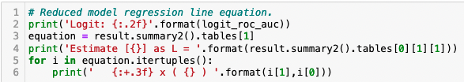
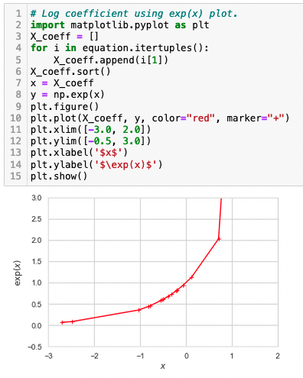
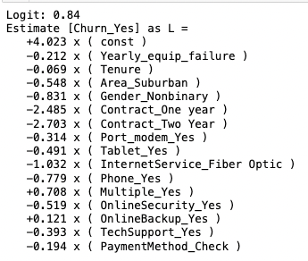
Final Model: Coefficients
Notes:
The final model summary produced a coefficient for each explanatory variable. They are listed in the figure shown. The coefficients are the log odds of the customer’s likelihood of churning from the company. The constant of 4.0647 along with the coefficient of the explanatory variable can be added or subtracted together to obtain a value equal to the likelihood of that customer churning from the company. Positive coefficients indicate a higher likelihood of a customer churning, while the negative coefficients indicate that the customer will be less likely to churn. As an example, considering the predictor variable of multiple_yes with a coefficient of +0.708. Calculating 4.023 + 0.708 = 4.731, we can see that if a customer has multiple services with the provider, they are more than four times likely to churn from the company. On the other hand, when viewing the feature of fiber optic service with a coefficient of -1.032, we see a different story. Performing the calculation of 4.023 – 1.032 = 2.991 shows that a customer who has fiber optic is less likely to churn.

Slide 35
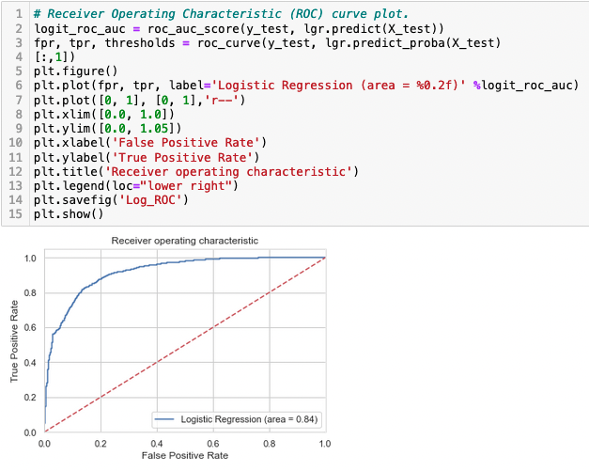
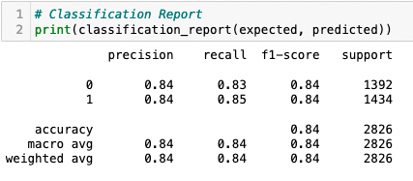
Final Model: Receiver Operating Characteristic
Notes:
The ROC curve is shown. The curve in the plot visualizes the ability of a random classifier as its discrimination threshold is varied. This tells how much the model can distinguish between the true positive rate vs. the false positive rate. (Hoo, Candlish, & Teare, 2017) The higher the accuracy, the more the curved line moves away from the dotted line of Y = 1. The area under this curve measures 0.84.

Slide 36
Results
Significance:
Model Prediction Accuracy of 84%
Can predict the likelihood of a customer to churn based on 15 features.
Limitations: Categorical values re-expressed with One-hot Encoding
Coefficients:
Constant: +4.023
Yearly_equip_failure: -0.212
Tenure: -0.069
Area_Suburban: -0.548
Gender_Nonbinary: -0.831
Contract_One Year: -2.485
Contract_Two Year: -2.703
Port_Modem_Yes: -0.314
Tablet_Yes: -0.491
InternetService_Fiber Optic: -1.032
Phone_Yes: -0.779
Multiple_Yes: +0.708
OnlineSecurity_Yes: -0.519
OnlineBackup_Yes: +0.121
TechSupport_Yes: -0.393
PaymentMethod_Check: -0.194
Notes:
The model created has proved to be accurate to an 84% rate. This is a practical model in determining the likelihood of a customer churning from the provider based on the presence of certain features. This model can be used to predict the most optimal combinations of services to offer customers, with the benefit of retaining the customer for a longer term.
A limitation of this analysis is when dealing with categorical features. One-hot encoding was used to re-express the categorical data as numerical. During this process, the drop_first method in Pandas is marked as True. If this is not done, or marked as False, the data will be redundant since it is binary. All the information needed is contained in just one column, so the second one is eliminated.
The coefficients or the log odds of the customer’s likelihood of churning from the company can be used to put together the optimal package to offer the customer with the intention of retaining their service for longer.

Slide 37
Recommendations
Offer bundle packages at a reduced rate
Extend contracts
Notes:
Based on the figures from the calculations, the provider would benefit from having customers sign up for multiple services. Offering bundle packages at a reduced cost to the customer would increase their likelihood of remaining at the provider for a longer period. Also, extending customer’s contracts will reduce the likelihood a customer will churn.

Slide 38

Questions
Notes:
Any questions?

